Slide 1

Welcome
Java Programming Primer
Notes:
Mandatory
ACTION: Adjust title to fit your course.

Slide 2
Prerequisites
This course assumes you:
Are interested in learning more about the Java language and building software applications using Java

Slide 3
Why study this subject?
Java is one of the most popular development languages in use today
Java can be used to build all kinds of modern applications – APIs, front-end applications, batch jobs, mobile apps, etc.
Getting some high-level exposure to Java and the mechanics of the language positions you for eventual participation in modern software engineering projects

Slide 4
My pledge to you
I will...
Make this interactive
Ask you questions
Ensure everyone can speak
Use an on-screen timer

Slide 5
Objectives
At the end of this course you will be able to:
Read and understand simple Java programs
Build upon a foundation that can fuel additional learning and help with taking on more challenging programming problems

Slide 6
Agenda
Java as a modern software engineering language
Data types & variables in Java
Java operators
Java conditionals
Java arrays
Java looping
Java classes

Slide 7
Java Overview

Slide 8
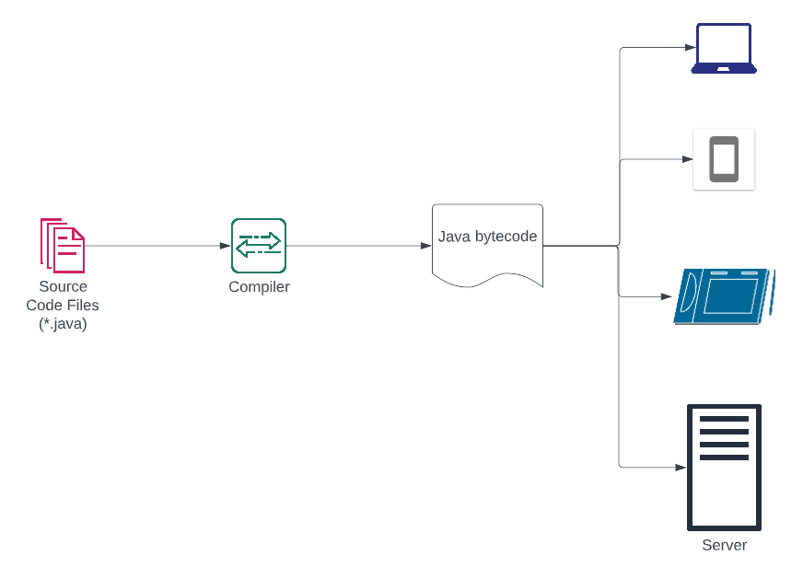
Java as a Modern Software Engineering Language

Slide 9
Java as a Modern Software Engineering Language
Source code created using Java language syntax and stored in 1 or more *.java files

Slide 10
Java as a Modern Software Engineering Language
A special program, called a “compiler” interprets the source code, validates it according to the rules of the language, and translates into executable code

Slide 11
Java as a Modern Software Engineering Language
Java bytecode is generated from the compiler – enables cross-platform (Windows, MacOS, Linux) execution of the program

Slide 12
Java as a Modern Software Engineering Language
A Java Virtual Machine (JVM) is available to different platforms, each of which knows how to execute the resulting bytecode

Slide 13




Characteristics of Java
Considered a “higher-order” language – more human-friendly
Object-oriented – seeks to define programming constructs in “real world” terms
Platform independent – “write once, run anywhere”
Secure language and platform for running business-critical apps

Slide 14
Types of Java Application
Standalone
Web Application
Enterprise Application
Mobile Application

Slide 15
Types of Java Application
Simple desktop application that can be installed and run independently on a system
Standalone
Web Application
Enterprise Application
Mobile Application

Slide 16
Types of Java Application
Standalone
Web Application
Web application – web pages and browser-based UI
Enterprise Application
Mobile Application

Slide 17
Types of Java Application
Standalone
Web Application
Distributed application used to support enterprise operations – APIs, microservices, etc.
Enterprise Application
Mobile Application

Slide 18
Types of Java Application
Standalone
Web Application
Enterprise Application
Mobile Application
Application intended for execution on a phone or tablet

Slide 19
Java Platforms
Java Standard Edition (Java SE)
Java Enterprise Edition (Java EE)
Java Micro Edition (Java ME)
Baseline features
Supports standalone application creation
Enterprise-ready version
Supports web application, API, microservice development
Focused on enabling mobile development

Slide 20
JRE vs. JDK
Stands for Java Runtime Environment
Provides platform-specific software for running Java applications
Implements the Java Virtual Machine (JVM)
JRE

Slide 21
JRE vs. JDK
Stands for Java Development Kit
Contains the JRE + development tools
Used for building Java applications
JRE
Dev Tooling
JDK

Slide 22

DEMO
Java “Hello, World”
Notes:
Walk through https://www.programiz.com/java-programming/hello-world, highlighting foundational parts of a standalone Java app – comments, class, main, output

Slide 23
DEMO
Java Basic Input & Output
Notes:
Walk through https://www.programiz.com/java-programming/basic-input-output – include, print() vs. println() vs. printf() / simple console-based input
Demonstrate printf() formatting – for example:
public class InputOutputDemo { public static void main(String[] args) { System.out.println("Sample string"); System.out.println(2.34); System.out.print("Hello, "); System.out.println("World!"); double number = 3.973353; String name = "Leroy Jenkins"; System.out.printf("%s\n", name); System.out.printf("%.3f\n", number); System.out.printf("%.1f\n", number); System.out.printf("%.5f\n", number); System.out.printf("%.4f\n", number); } }

Slide 24
Java Data Types & Variables

Slide 25


Java Data Types
Primitive
Non-Primitive
Notes:
Primitive – basic, out-of-the-box types included with Java
Non-primitive – more advanced types composed from the primitive types and other non-primitive types (class hierarchies)

Slide 26
Java Data Types - Primitive
Type | Brief Description
boolean | Stores “true” or “false”; used in conditional expressions
byte | Integer type intended to represent a single character or smaller signed whole number
short | Slightly larger (than byte) signed whole number
int | Larger signed whole number; commonly used to represent whole numbers in code
long | Much larger signed whole number; used for cases where extremely large whole number is required
double | Used to represent decimal numbers (64-bit)
float | Used to represent decimal numbers (32-bit)
char | Used to represent a 16-bit Unicode character
String | Used to represent a string of text
Notes:
Primitive – basic, out-of-the-box types included with Java
Non-primitive – more advanced types composed from the primitive types and other non-primitive types (class hierarchies)

Slide 27


Java Variables
Represents a named location in memory that can be used for storing data
Includes a type and, optionally, an initial value
Variable values can change during a program’s execution, but type remains fixed
Variable names must follow a set of defined syntax rules in the language
Use names that improve readability of the code – i.e., use a name for a variable that indicates what it is being used for in the program
Notes:
Variable naming rules: names are case sensitive (as is all of Java); name must start with a letter, an underscore, or a $; cannot start with numbers; cannot include whitespace

Slide 28

Java Variables & Literal Values
Literal values are fixed values coded into the program
Variable can be assigned literal value, value from other variables, result of calculations, result of method calls, etc.

Slide 29
DEMO
Java Data Types, Variables, & Literals
Notes:
Walk through https://www.programiz.com/java-programming/variables-primitive-data-types and https://www.programiz.com/java-programming/variables-literals

Slide 30
Java Operators

Slide 31
Java Operators
Arithmetic Operators
Assignment Operators
Relational Operators
Logical Operators
Unary Operators
Other Operators

Slide 32
Arithmetic Operators
Operator | Brief Description
+ | Addition
- | Subtraction
* | Multiplication
/ | Division; used with two integers, results in an integer; if at least one operand is a decimal value, results will be a decimal value; division by 0 not allowed
% | Modulo; represents remainder post division (e.g., 9%2 = 1)

Slide 33
Assignment Operators
Operator | Brief Description
= | Assignment; assigns value on right-hand side to variable on left-hand side (e.g., int a = 3)
+= | Addition and reassignment shortcut; used to increase a variable on left-hand side by the value on right-hand side (e.g., a += 3 ➔ a = a + 3)
-= | Subtraction and reassignment shortcut; used to decrease a variable on left-hand side by the value on right-hand side (e.g., a -= 3 ➔ a = a - 3)
*= | Multiplication and reassignment shortcut; used to multiply a variable on left-hand side by the value on right-hand side (e.g., a *= 3 ➔ a = a * 3)
/= | Division and reassignment shortcut; used to divide a variable on left-hand side by the value on right-hand side (e.g., a /= 3 ➔ a = a / 3)
%= | Modulo and reassignment shortcut; used to assign the results of calculating modulo of variable on left-hand side and value on right-hand side (e.g., a %= 3 ➔ a = a % 3)

Slide 34
Relational Operators
Operator | Brief Description
== | Tests equality of given operands and results in true or false; e.g., 2 == 2 will be true but 2 == 8 will be false
!= | Tests inequality of given operands and results in true or false; e.g., 2 != 2 will be false but 2 != 8 will be true
> | Tests if value of operand on left-hand side is greater than value of operand on right-hand side, resulting in true or false; e.g., 2 > 1 will be true but 2 > 5 will be false
< | Tests if value of operand on left-hand side is less than value of operand on right-hand side, resulting in true or false; e.g., 1 < 2 will be true but 5 < 5 will be false
>= | Tests if value of operand on left-hand side is greater than or equal to value of operand on right-hand side, resulting in true or false; e.g., 8 >= 8 will be true but 5 >= 8 will be false
<= | Tests if value of operand on left-hand side is less than or equal to value of operand on right-hand side, resulting in true or false; e.g., 1.99 <= 1.99 will be true but 1.99 <= 1.50 will be false

Slide 35
Logical Operators
Operator | Brief Description
&& | Logical AND used to check a compound expression for true or false; only true if both operands evaluate to true; e.g., (7 > 6) && (1.2 > 1.1) will be true but (7 > 6) && (1.2 == 1.1) will be false
|| | Logical OR used to check a compound expression for true or false; true if either operand (or both) evaluates to true; e.g., (7 > 6) || (1.2 == 1.1) will be true but (6 > 7) || (1.2 == 1.1) will be false
! | Logical NOT used for negative check of boolean expression; will result in true if applied to a false condition and false if applied to a true condition; e.g., !(1.2 == 1.1) will be true but !(4 < 5.8) will be false

Slide 36
Unary Operators
Operator | Brief Description
- | Unary minus used to invert the sign of a number or expression
++ | Increment operator providing a shortcut for increasing a value by 1; e.g., a++ ➔ a = a + 1
-- | Decrement operator providing a shortcut for decreasing a value by 1; e.g., a-- ➔ a = a - 1

Slide 37
Other Operators
Operator | Brief Description
instanceof | Checks if the object on left-hand side is an instance of a particular class (on right-hand side); e.g., “Hello, World!” instanceof String will result in true
ternary | Provides a shortcut for a conditional expression – format is <boolean expression> ? <true result> : <false result>; e.g., (1.9 > 1.5) ? “larger” : “smaller” will result in “larger” while (1.9 == 1.5) ? “equal” : “unequal” will result in “unequal”

Slide 38
DEMO
Java Operators – Arithmetic Operators
Notes:
Walk through Arithmetic Operators demo in https://www.programiz.com/java-programming/operators

Slide 39
DEMO
Java Operators – Assignment Operators
Notes:
Walk through Assignment Operators demo in https://www.programiz.com/java-programming/operators

Slide 40
DEMO
Java Operators – Relational Operators
Notes:
Walk through Relational Operators demo in https://www.programiz.com/java-programming/operators

Slide 41
DEMO
Java Operators – Logical Operators
Notes:
Walk through Logical Operators demo in https://www.programiz.com/java-programming/operators

Slide 42
DEMO
Java Operators – Unary Operators
Notes:
Walk through Unary Operators demo in https://www.programiz.com/java-programming/operators; if time permits, include a brief discussion of difference between prefix vs. postfix versions (when used as part of a larger expression, prefix will execute increment or decrement before evaluating larger expression; postfix will execute increment or decrement after evaluating larger expression)

Slide 43
Java Conditionals

Slide 44

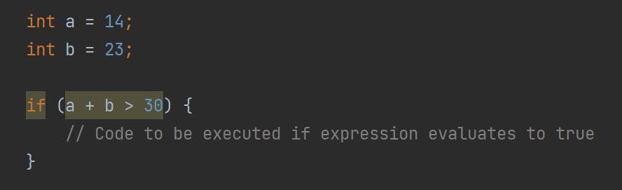
if Statement
Java statement used to enable conditional execution of a block of source code
Using an if…then construct, able to evaluate a boolean expression (true or false)
If the expression evaluates to true, code defined within code block is executed

Slide 45
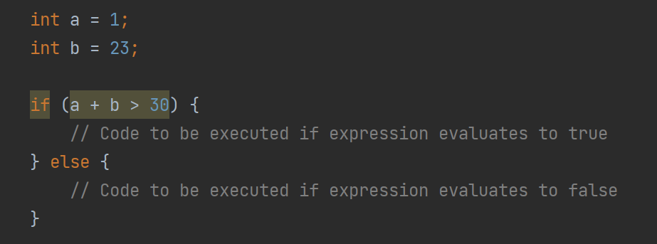
if-else Statement
Allows definition of an optional block of code to be executed if boolean expression evaluates to false
Lets you route between 2 different potential paths in your code
If the expression evaluates to false, else block executed automatically

Slide 46
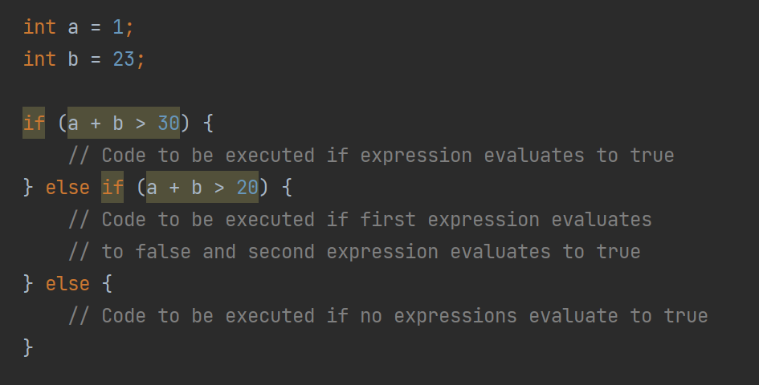
if-else-if Statement
Allows definition of additional, optional intermediate conditions to be evaluated as part of control flow
If initial expression evaluates to false, Java will check each included else-if for a “true” match
If none of the “branches” match, else block gets executed (if coded)

Slide 47
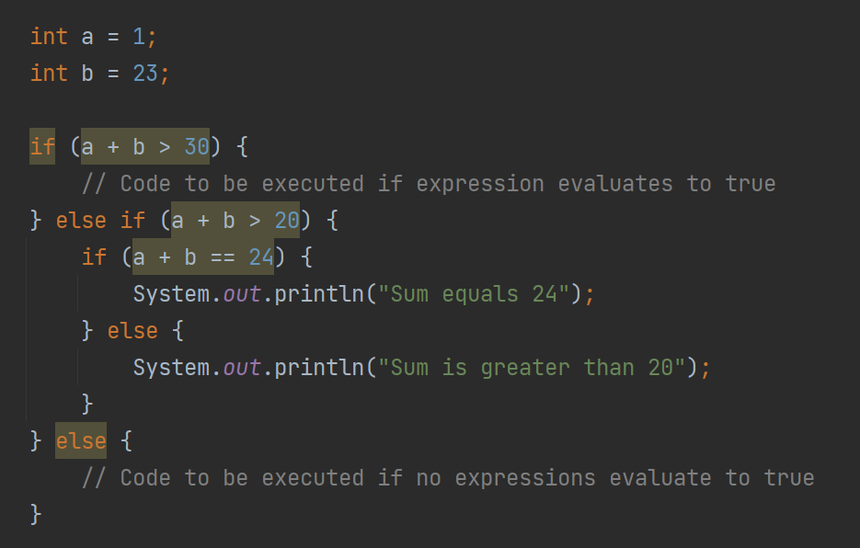
if Statement Nesting
A separate if check (with optional else-if and else blocks) can be nested in an if statement
This allows for testing multi-level conditions
Can also use logical operators (&& or ||) to use a multi-level expression on the if statement itself

Slide 48
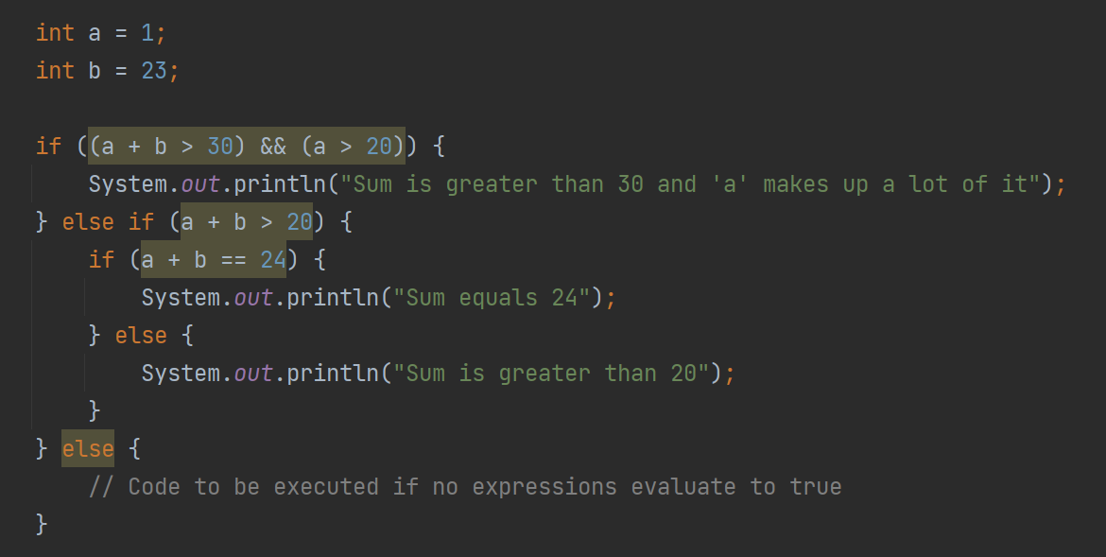
if Statement Nesting

Slide 49
switch Statement
Java statement used to check a value against multiple options and execute code for the option that matches
Can be useful when you need to check against a discrete number of possibilities
Supports definition of a “default” case if none of the other values match
A “break” statement in the cases prevents fallthrough from one case to the next – “break” exits the switch once a matching case has been found

Slide 50
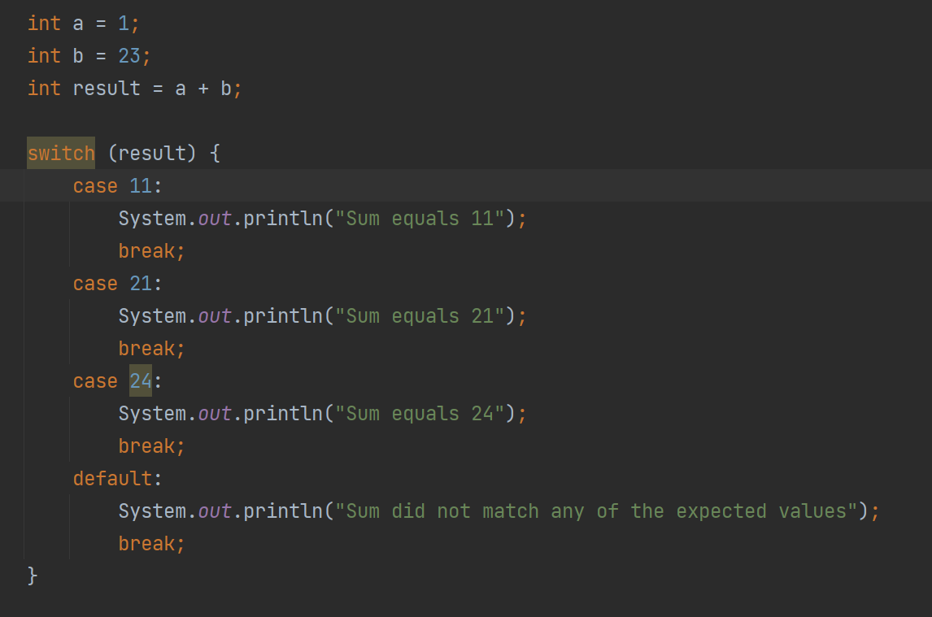
switch Statement

Slide 51
DEMO
Java if Statement (and Variants)
Notes:
Walk through demos in https://www.programiz.com/java-programming/if-else-statement

Slide 52
DEMO
Java switch Statement
Notes:
Walk through demos in https://www.programiz.com/java-programming/switch-statement

Slide 53
Java Arrays

Slide 54

Arrays
Java mechanism that allows us to define a collection of multiple “things” of the same type
Uses a type to dictate what types of “things” the collection will hold
Uses square brackets to define the number of “things” the collection will include
Allows reference to the entire set by name as well as reference to an individual element of the set
Looping (which we’ll talk about in the next section) can be used to process the set one-by-one

Slide 55
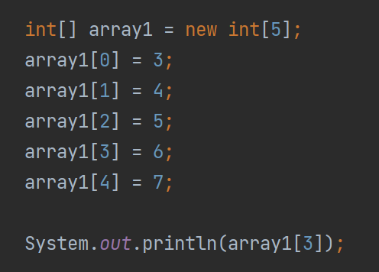
Arrays
We can declare the array and assign elements after-the-fact
Elements can be set and referenced by a 0-based index
Indexes for elements range from 0 to the length of the array - 1

Slide 56
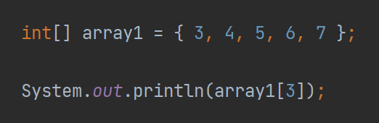
Arrays
Alternatively, the array can be defined, and the elements initialized at time of declaration
With this syntax, the size of the array is inferred from the number of elements assigned on creation

Slide 57
DEMO
Java Arrays
Notes:
Walk through demos in https://www.programiz.com/java-programming/arrays

Slide 58
Java Looping

Slide 59

Looping Statements
At times in our Java code, we may need to execute the same set of statements multiple times
In some cases, we know exactly how many times we want to execute them
In other cases, we allow activity in our code at runtime to decide the number of iterations we execute for a set of repeated logic
Allows us to reuse the same statements for multiple executions

Slide 60
Looping Statements
for Loop
for-each Loop
while Loop

Slide 61
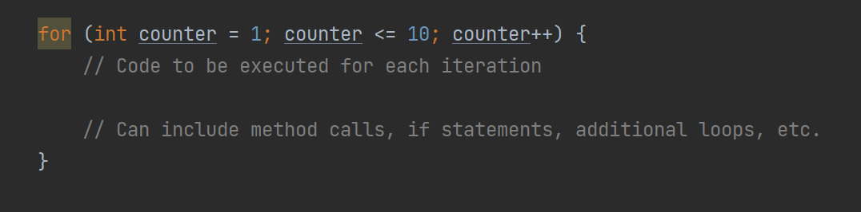
for Loop
Uses a standard format for defining a loop
Usually includes an initial expression or assignment, a test to determine if looping should stop, & a statement to move us to loop completion (instead of an infinite loop)
Usually used when we know the discrete number of times that a block of code should be executed

Slide 62
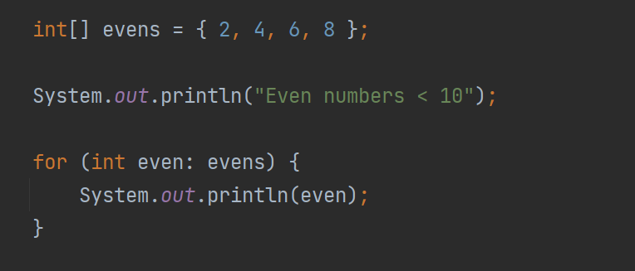
for-each Loop
Defines a loop that should execute for each element of a given array
Useful when you need to leverage the same logic for every element in a collection of things

Slide 63
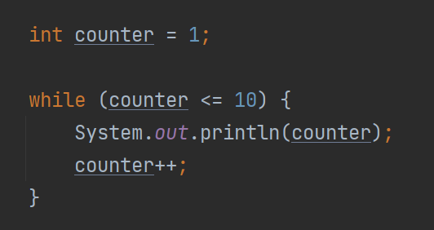
while Loop
Defines a loop that should execute while a boolean expression remains true
Allows runtime determination of number of iterations to execute for a given set of logic
Could be that no iterations execute if boolean expression evaluates to false from the start

Slide 64
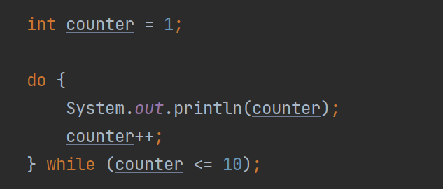
do-while Loop
Variation on while-style loop
Places boolean expression check at end of loop body
Ensures that loop body executes at least once

Slide 65
DEMO
Java for Loop
Notes:
Walk through demos in https://www.programiz.com/java-programming/for-loop

Slide 66
DEMO
Java for-each Loop
Notes:
Walk through demos in https://www.programiz.com/java-programming/enhanced-for-loop

Slide 67
DEMO
Java while Loop
Notes:
Walk through demos in https://www.programiz.com/java-programming/do-while-loop

Slide 68
Java Classes

Slide 69
Classes vs. Objects
Java is an object-oriented language
Allows us to model real-world entities in Java code for programmatic access and processing
Enables us to define the “shape” of an entity in our code – what attributes it should have and what behaviors it should support

Slide 70
Classes vs. Objects
Classes define the shape of the entity but do not represent any actual entity instances
Classes are like a blueprint or cookie cutter – they define what something will look like that is created from it but do not represent a concrete entity
To create concrete instances of the blueprint, we create objects – the house built from the blueprint, or the cookies created with the cookie cutter
We know each concrete instance will have the same properties (though property values will be different from instance-to-instance) and the same behaviors

Slide 71
Classes vs. Objects
To create a new instance of the defined template, we use the “new” operator
The results of the “new” operator will likely be stored in an object reference (a variable that we can use in our code)
To access the specific property values of the object (and the methods defined for its type), we can use the dot notation

Slide 72
Object-Oriented Programming (OOP)
Encapsulation
Inheritance
Polymorphism
Notes:
OOP includes 3 key characteristics

Slide 73

Encapsulation
An object should protect its internal state
If code using the object wants to read or change its state, the object should force access through the defined methods
Provides the class/object with an opportunity to validate the intended action to be sure it won’t jeopardize the integrity of the entity

Slide 74

Inheritance
Supports the creation of a hierarchy of related entity types
For example, an employee type (that defines attributes all employees possess), and creation of a salaried employee type and hourly employee type (with different behaviors but certain shared characteristics that are valid for all employee types)
Helps us design rich data models that map more closely to reality
Goal is to make the software look as much like the real business climate as possible to cut down on gaps

Slide 75

Polymorphism
Literally means “many forms”
In OOP, helps us leverage “context” for determining what a specific behavior or functionality means
Supports management of complex relationships in our code bases that can be dynamically applied during software execution
As an example, we can “open” a door and “open” a book – same verb but meaning is defined by context in which it is used

Slide 76

Access Modifiers
When defining a class in Java, we can mark certain members as “private” (internal access only)
Other members can be marked with “public” (accessible from outside of the class)
Often, we define the attributes (or state) of the object using “private” – helps us protect the internal state

Slide 77
Access Modifiers
Methods (or behaviors) can be marked with “private” or “public” – “private” if we expect the method to be used internal to the class only; “public” if we want to expose the behavior to the outside world
There are other access modifiers as well – support more intermediate/advanced scenarios

Slide 78

Constructors
Special kind of “method” defined on the class
Has same name as class – can accept parameters but has no return type
Used to initialize a new instance of the class (when calling the “new” operator)
Enables setting of initial state (with corresponding logic, if required) on object creation

Slide 79
DEMO
Java Class and Objects
Notes:
Walk through demos in https://www.programiz.com/java-programming/class-objects

Slide 80
DEMO
Java Methods
Notes:
Walk through demos in https://www.programiz.com/java-programming/methods

Slide 81
DEMO
Java Access Modifiers
Notes:
Walk through demos in https://www.programiz.com/java-programming/access-modifiers

Slide 82
DEMO
Java Constructors
Notes:
Walk through demos in https://www.programiz.com/java-programming/constructors

Slide 83
DEMO
Bringing it All Together
Notes:
Walk through demo in https://github.com/KernelGamut32/onboarding_java_primer/tree/main/demos/Labs (docx describes tasks and “solution” folder includes solution for demo to students).

Slide 84




Thank you!
If you have additional questions, please reach out to me at:
(email address)

